Slide 1

Gopalganj Science and Technology University
Presentation on
Sentiment Analysis of the Marma Language Using Machine Learning Techniques
Presented by | Supervised by
Name: Mohammad Nimour Hossain ID: 20CSE010 Name: Iftaker Siddique ID: 20CSE036 4th Year, 1st Semester Department of CSE, GSTU | Name: Dr. Mrinal Kanti Baowaly, Associate Professor Department of CSE, GSTU
Department of Computer Science and Engineering

Slide 2

Presentation Outline
Introduction
Research gap
Objectives
Dataset Description
Methodology (Preprocessing & Features)
Machine Learning Models
Expected Results
Completed Work Summary
Pending Works
Related work
Conclusion
Department of Computer Science and Engineering

Slide 3
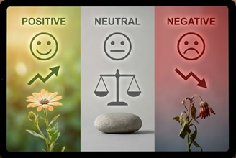
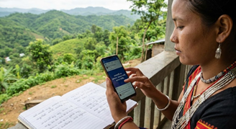
Introduction
• This research aims to classify Marma sentences as Positive, Negative, or Neutral using Machine Learning techniques.
• Marma is spoken by around 200,000 people in the Chittagong Hill Tracts.
• Although Marma has its own script, most speakers write the language using Bangla characters on social media.
Department of Computer Science and Engineering

Slide 4
Research gap
• Marma lacks a large dataset or any working digital tool for sentiment analysis.
• Its grammar is very different from Bangla, so Bangla NLP systems don’t work.
• This creates a digital gap, leaving the Marma community behind in AI access.
• Our project focuses on developing an ML model that can read and classify Marma text automatically.
Department of Computer Science and Engineering

Slide 5
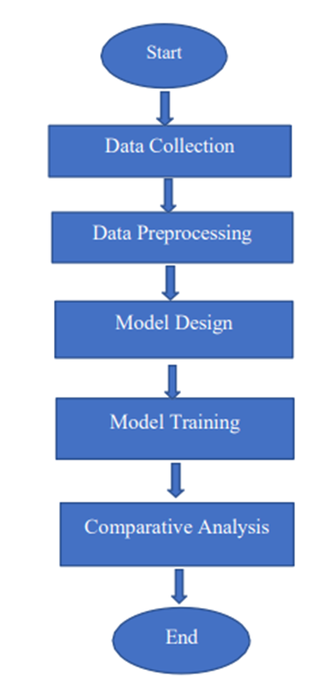
Objectives
Data Collection:
We create and expand a translated Bangla-to-Marma sentiment dataset.
Data Preprocessing:
We clean, tokenize, remove stopwords, and normalize the text.
Model Design:
We use CountVectorizer with Unigram–Bigram features.
Model Training:
We will train SVM, KNN, Decision Tree, and Logistic Regression on an 80/20 split.
Comparative Analysis:
We will evaluate models using Accuracy and F1 to find the best one.
Department of Computer Science and Engineering

Slide 6
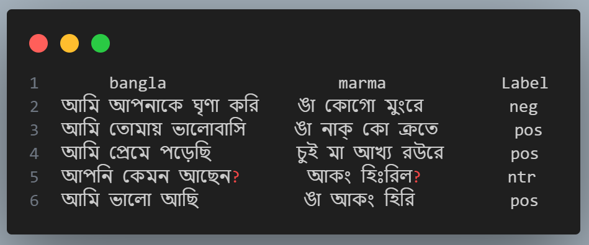
Dataset Descriptions
• Collection: We are creating the Marma dataset through manual translation of Bangla sentences by Marma students.
• Labels: We are tagging the translated Marma sentences as Positive, Negative, or Neutral.
• Script: We are writing all Marma sentences using the Bangla script.
Department of Computer Science and Engineering

Slide 7
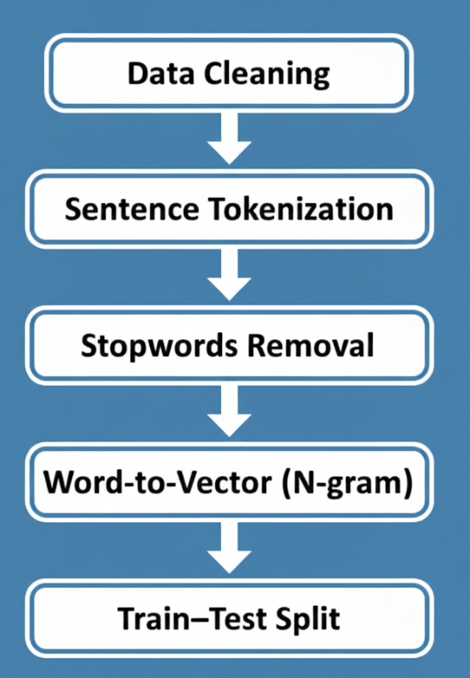
Methodology
Data Cleaning
Sentence Tokenization
Stopwords Removal
Word-to-Vector (N-gram)
Train–Test Split
Department of Computer Science and Engineering

Slide 8
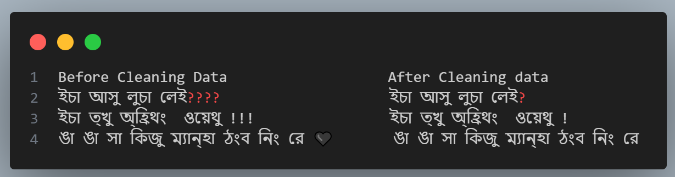
Methodology(Cont..)
Data Cleaning:
Character Removal: We remove all symbols, numbers, and English letters.
Link & Tag Removal: We delete website links, HTML tags, and line-break codes.
Punctuation Fix: We fix repeated punctuation marks ( !!!, ??).
Code/Emoji Cleanup: We remove unwanted character codes and emojis from the text.
Department of Computer Science and Engineering

Slide 9
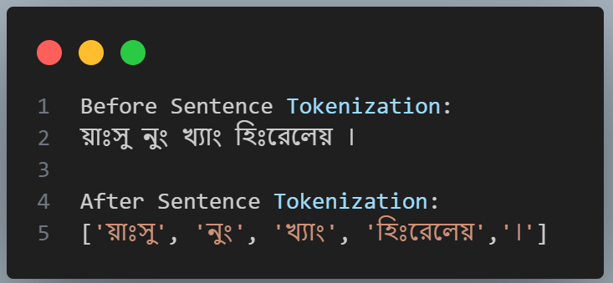
Methodology(Cont..)
Sentence Tokenization:
Break Sentences: We split each sentence into individual words.
Split by Space: Sentences are divided wherever there is a space.
Output Tokens: The final result is a list of clean word tokens.
Department of Computer Science and Engineering

Slide 10
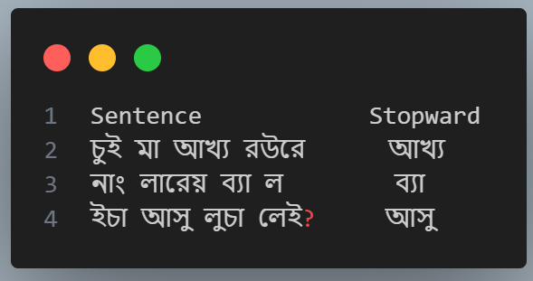
Methodology(Cont..)
Stopwords Removal:
Custom List: We create a custom list of common words (“আখ্য”, ”ব্যা”, “আসু”).
Filtering: The system checks each word and removes any matches from the list.
Final Goal: This eliminates words with no emotional meaning, making the text cleaner.
Department of Computer Science and Engineering

Slide 11
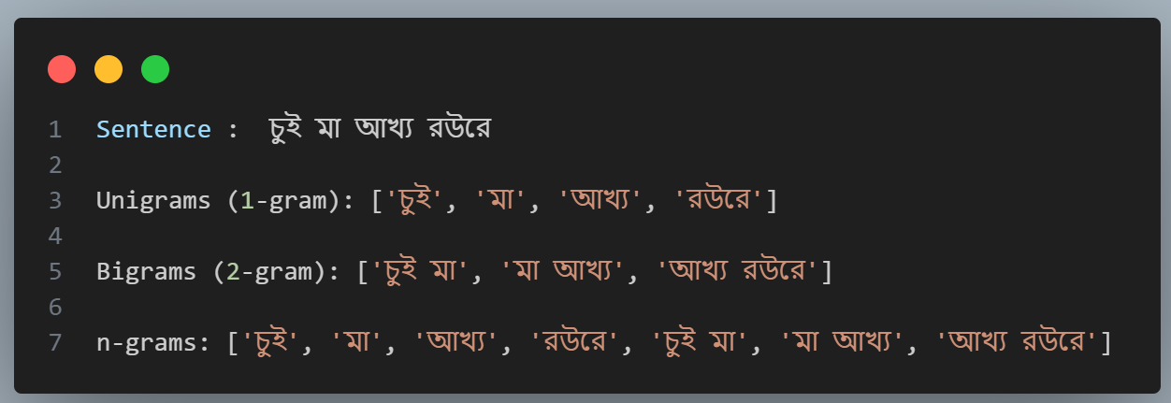
Methodology(Cont..)
Word-to-Vector (N-gram):
Goal: We convert each clean Marma word into a numeric representation (vector).
Tool: We use CountVectorizer for this conversion.
Feature Type: We capture both single words (unigrams) and two-word pairs (bigrams).
Department of Computer Science and Engineering

Slide 12
Methodology(Cont..)
Train–Test Split :
Goal: We split the dataset to test the model on unseen examples.
Ratio: 80% of the data is used for training, and 20% is reserved for testing.
Training Set: This larger portion is used to teach the model.
Testing Set: This portion is kept separate to measure true performance.
Random State: We use a fixed value to ensure the split is consistent every time.
Department of Computer Science and Engineering

Slide 13
Machine Learning Models
• Logistic Regression (LR): Our simple model for separating data.
• Support Vector Machine (SVM): Finds the widest margin to divide classes.
• K-Nearest Neighbors (KNN): Classifies text by looking at the closest examples.
• Decision Tree: Uses rule-based trees to categorize sentiment.
Department of Computer Science and Engineering

Slide 14
Expected Results
• Target Score: We will aim for high accuracy.
• Top Model: Expected to perform the best, though not run yet.
• Metrics Used: We will measure performance using Accuracy and F1-Score.
• Benchmark: This project will establish the first benchmark for Marma sentiment analysis.
Department of Computer Science and Engineering

Slide 15
Completed Work Summary
Collected 200+ Bangla–Marma sentence pairs from Marma students.
Reviewed existing sentiment-analysis workflows from other languages.
Studied Data Cleaning, Tokenization, Stopword Removal, N-gram Vectorization, and Train–Test Split methods.
Planned execution steps with supervisor guidance.
Tested sentiment-analysis flow using a Bangla dataset as a reference.
Department of Computer Science and Engineering

Slide 16
Pending Works
Collect full Marma dataset physically from students.
Label all collected sentences properly.
Perform Data Cleaning, Tokenization, Stopword Removal, N-gram Vectorization, and Train–Test Split on the dataset.
Train and test multiple models (Logistic Regression, SVM, KNN, Decision Tree) for accuracy comparison.
Select the best-performing model for thesis finalization.
Department of Computer Science and Engineering

Slide 17
Related Works
Bengali Sentiment Analysis – Md. Saiful Islam, 2016
Hindi Sentiment Analysis – Sheetal Sharma, 2018
Urdu Sentiment Analysis – Mohammad Abid Khan, 2017
Arabic Sentiment Analysis – Ahmad Al-Sallab, 2015
Myanmar/Burmese Sentiment Analysis – Yu Mon Aye, 2018
Department of Computer Science and Engineering

Slide 18
Conclusion
This thesis is still in progress, and we will work on sentiment analysis for the Marma language.
We will develop a dataset and apply various machine learning methods.
Overall, this work will guide future research and support the digital development of the Marma language.
Department of Computer Science and Engineering

Slide 19
Thank You
Department of Computer Science and Engineering

